Slide 1
CODE LIKE ESCHER
Science Literacy Week
- McMaster Start Coding-

Slide 2

Land Acknowledgement
While traveling from different locations, McMaster University is a common location that ties us together.
McMaster University recognizes and acknowledges that it is located on the traditional territories of the Mississauga and Haudenosaunee nations, and within the lands protected by the “Dish with One Spoon” Wampum agreement.
Please take the time to learn more about the lands on which you are located: https://native-land.ca
Notes:
A: We acknowledge the traditional territories upon which we gather; McMaster University is located on the traditional territories of the Mississauga and Haudenosaunee nations, and within the lands protected by the “Dish with One Spoon” wampum agreement”. For many thousands of years, the first people sought to walk gently on this land, offering their assistance to the first European travelers and sharing their knowledge for survival in what was at times a harsh climate. We seek a new relationship with the original peoples of this land, one based in honor and deep respect. May we be guided by respect and right action as we transform of our personal and institutional relationships with our indigenous friends and neighbors.

Slide 3
Introduction
Notes:
Introduce yourself and let the kids do it: Name, pronouns, fun fact

Slide 4
Ice Breaker
Notes:
Have students choose between 2 options, eg: chocolate vs candy, dogs vs cats, movies, vs books, etc. Used for creating groups

Slide 5
DAY 1
Science Literacy Week
Today we will create objects using simple shapes!

Slide 6
Day 1
ELM
Make basic shapes
01
02
Colour theory
Functions and grouping
03
04
We will discuss about what elm is
We will learn how to code shapes in elm
We will explore what colour theory is and how to use it!
We will learn about functions and grouping!

Slide 7


ELM
Elm is a pure functional programming language
We will learn how to make animations and cool things in elm!

Slide 8
To the platform!
Let’s learn how to make basic shapes and about colour theory!

Slide 9
Functions
It is a block of code that is used to perform a single action
We can call this function instead of saying how to do a certain thing again and again

Slide 10
Grouping
Similar to functions, we can group a bunch of objects to create a shape and use it every time we want that object instead of typing all the shapes again

Slide 11
DAY 2
Science Literacy Week
Today we will create cool and fun animations!
Notes:
Use the shape creator and show examples to explain

Slide 12
Day 2
Transformations
Animations
01
02
Fractals
03
We will learn what it is
We will learn how to make animations
We will discuss what it is and look at examples

Slide 13
Transformations
We can manipulate our shapes by rotating, scaling and resizing them!

Slide 14
To the platform!
Let’s learn about animations and how to implement them!

Slide 15
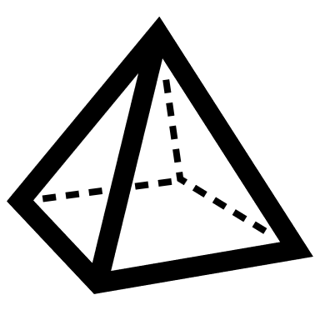
Fractals
They are complex patters that have small shapes repeated in different ways

Slide 16
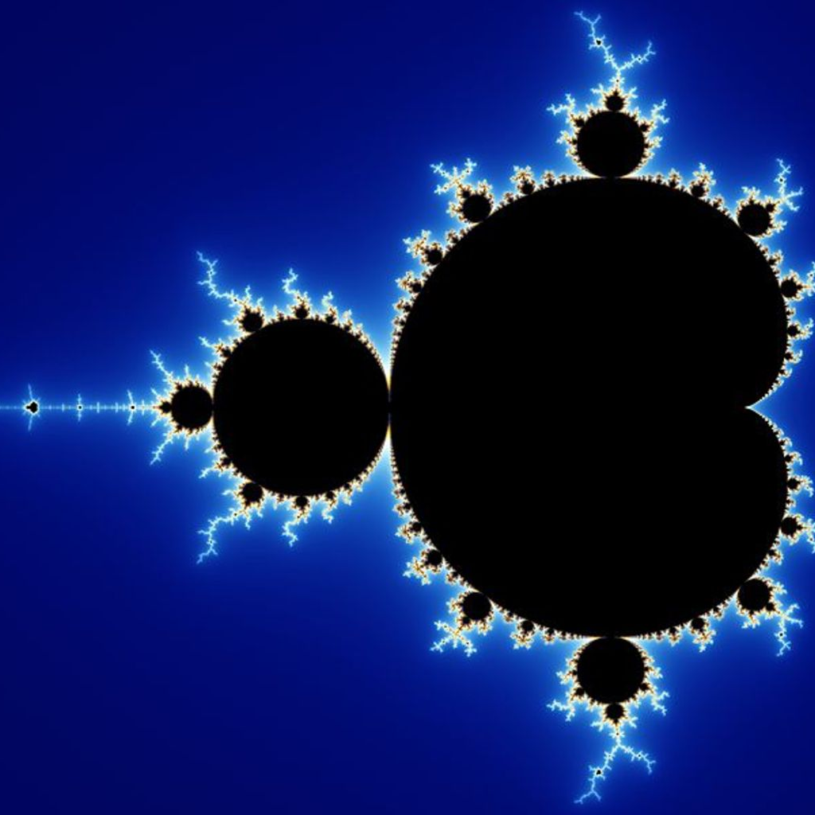
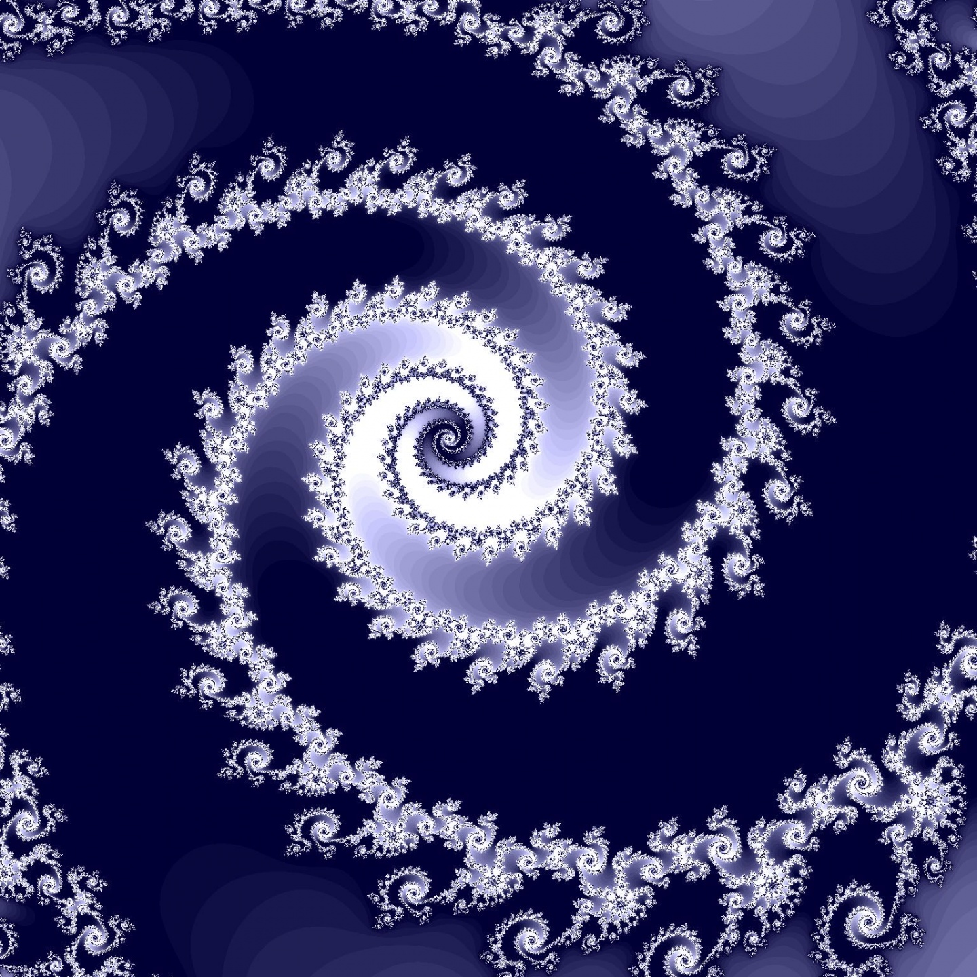

Slide 17
DAY 3
Science Literacy Week
Today we will make animations using symmetry!
Notes:
Use the shape creator and show examples to explain

Slide 18
Day 3
Tessellations
Escher
01
02
Symmetry
03
We will learn what it is
We will explore who that is
We will discuss about its importance in Escher’s art

Slide 19
Tessellations
It is a pattern of shapes repeated to fill a plane

Slide 20
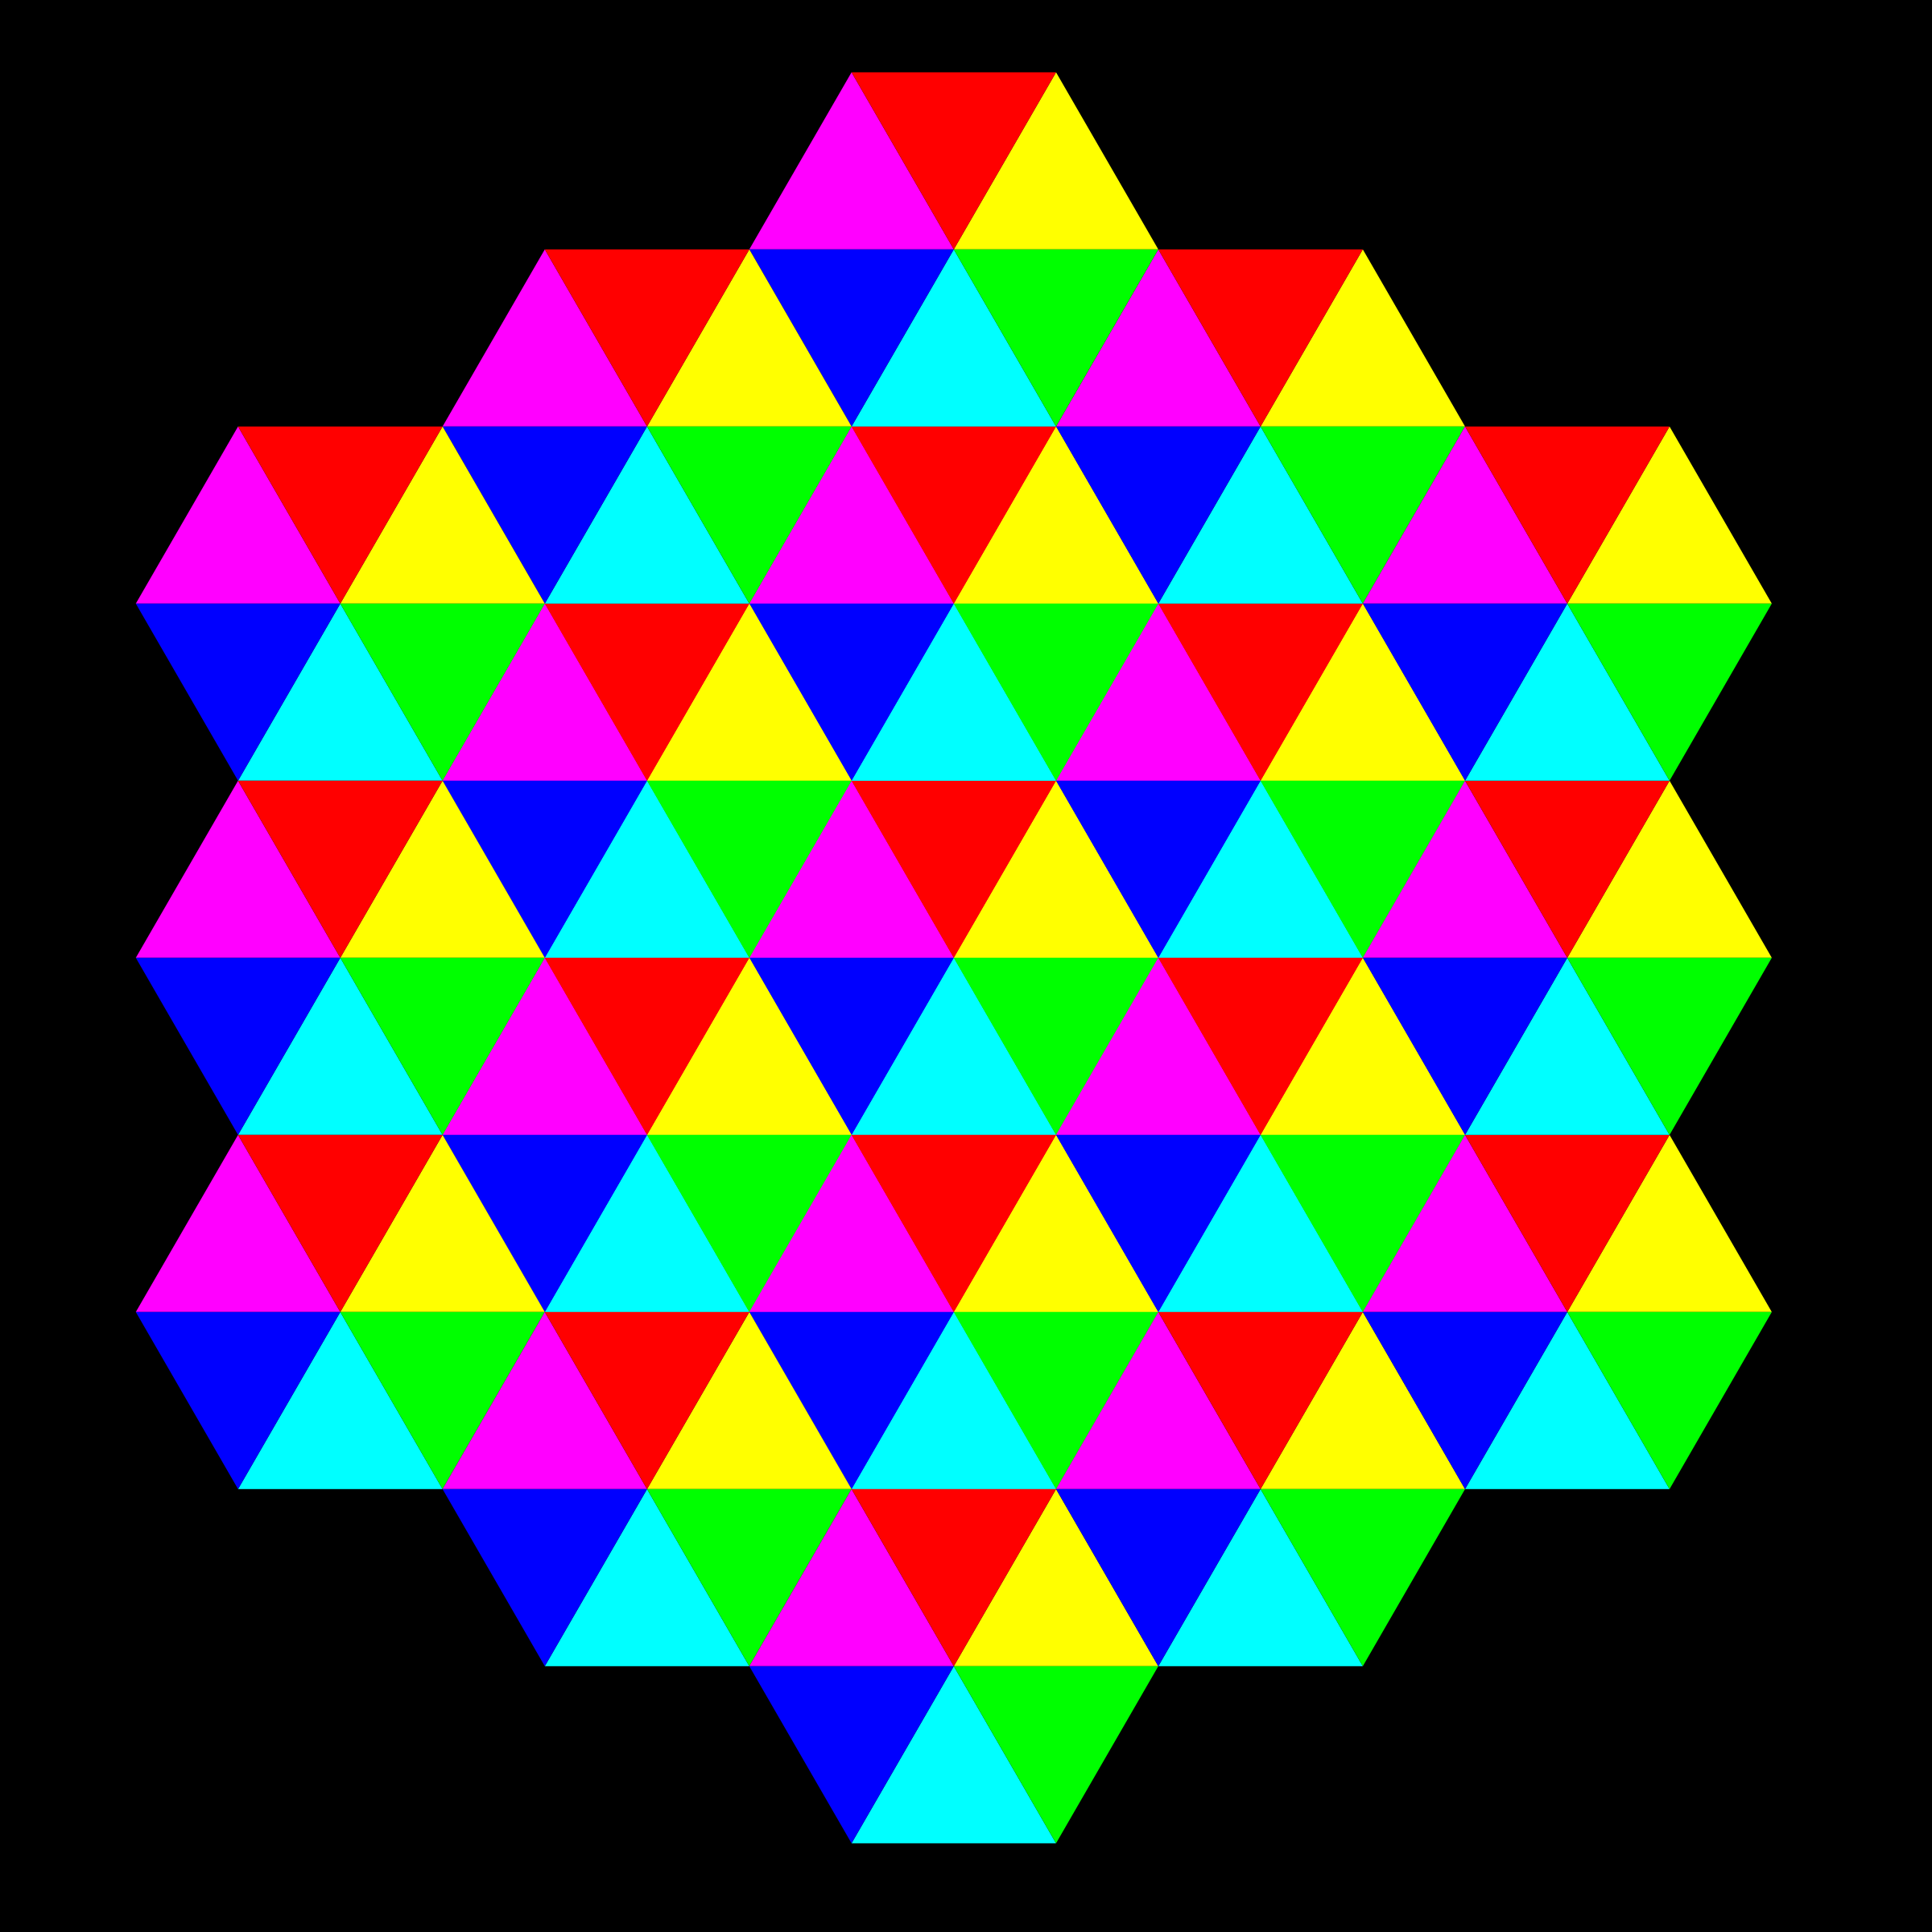
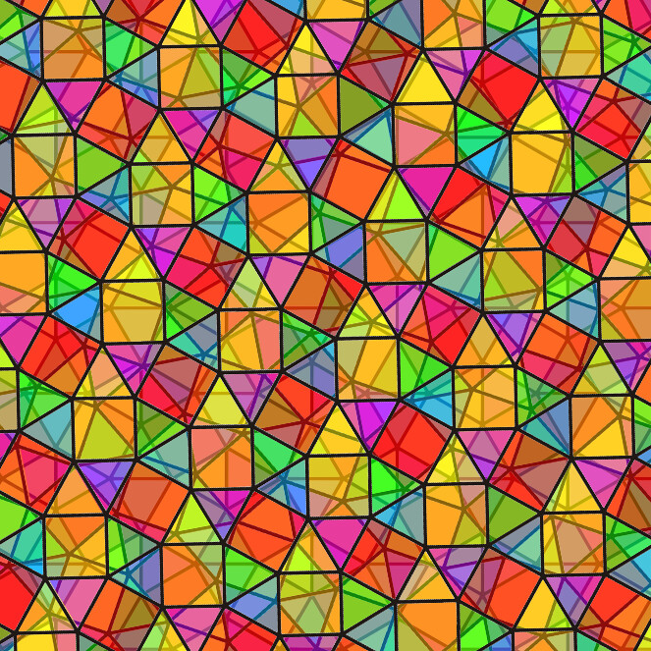

Slide 21
Escher
Maurits Cornelis Escher was a Dutch artist
He made symmetry famous and then started bending it!

Slide 22
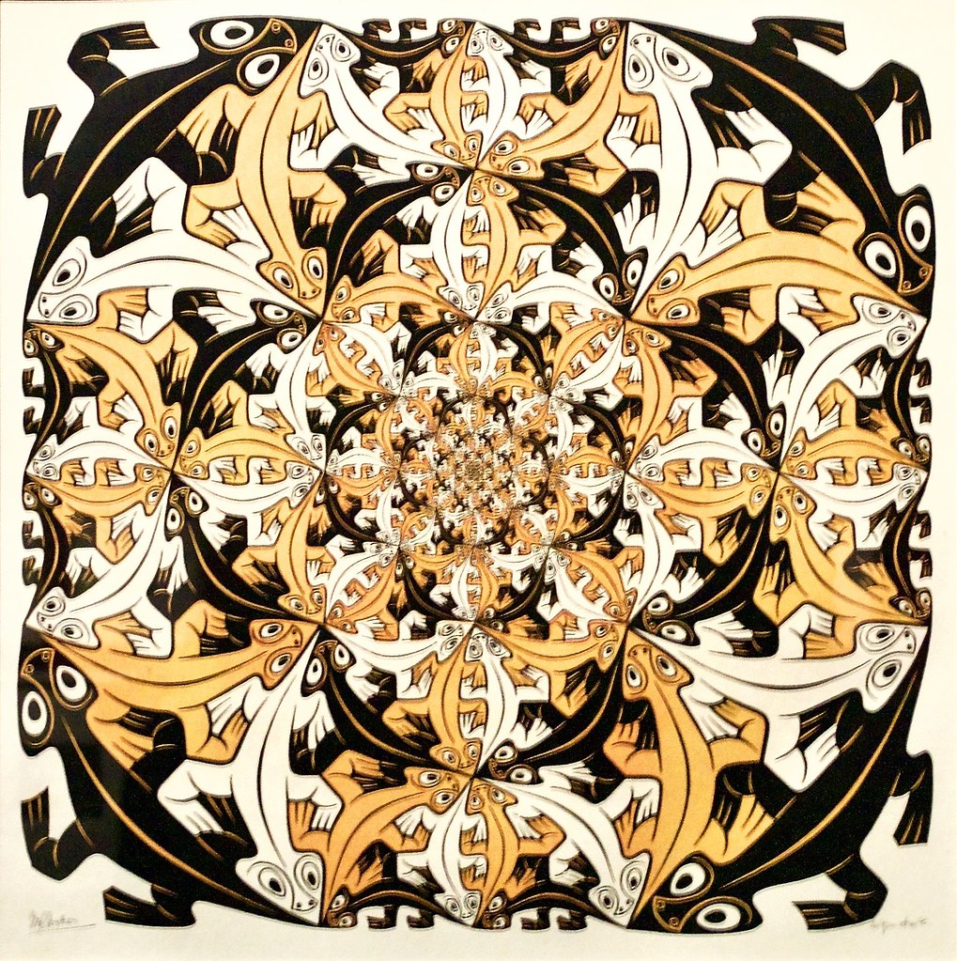
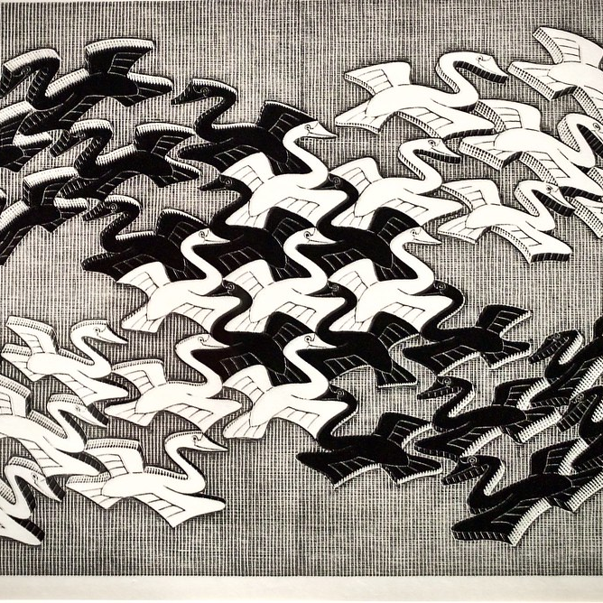

Slide 23
Symmetry
Two sides that are almost exactly the same in size, shape or position!
Escher’s artwork has abundance of symmetry!

Slide 24
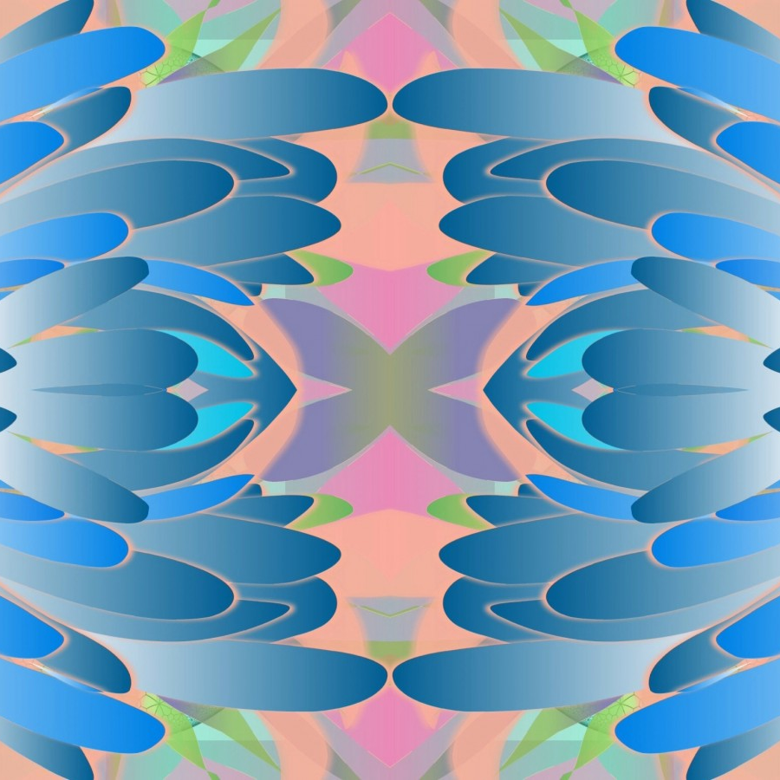
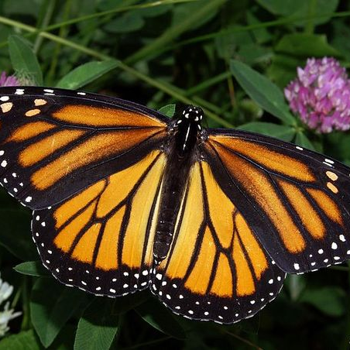

Slide 25
DAY 4
Science Literacy Week
Today we will use recursion to make animations
Notes:
Use the shape creator and show examples to explain

Slide 26
Day 4
If then else
Loops
01
02
Recursion
Idea factory
03
04
We will introduce what they are
We will learn about the different types of loops
We will explore what it is and how to use it
We will come up with ideas we want to make!

Slide 27
If then else
If a statement is true, then it will do something or else it will do another thing
Notes:
Explain with example

Slide 28
Loops
Loops are used to repeat the same amount of code
There are 2 kinds of loops: for and while
Notes:
Explain with example

Slide 29
Recursion
In functional programming, recursion is used to loop using if then else statements
Recursive functions call on themselves to loop
Notes:
Explain with example

Slide 30

IDEA FACTORY
Let’s brainstorm and share our ideas!

Slide 31
DAY 5
Science Literacy Week
Today we will bring our ideas to life and present them!
Notes:
Use the shape creator and show examples to explain

Slide 32
Recap
Let us share what new things we learnt and our favourite part of the week!

Slide 33
THANKS!
Science Literacy Week

